Slide 1



Accenture | Australia & New Zealand
Zero-Touch IAM Security
AI-Powered Complex Process Automation
Built with Google ADK & Agent-to-Agent Protocol
Google Agent Build Challenge
November 28, 2025

Slide 2



The IAM Provisioning Problem
Manual approvals take hours
Policies scattered across systems
Privileged operations expose attack surface
Zero-Touch IAM Security automates the entire workflow with AI agents

Slide 3
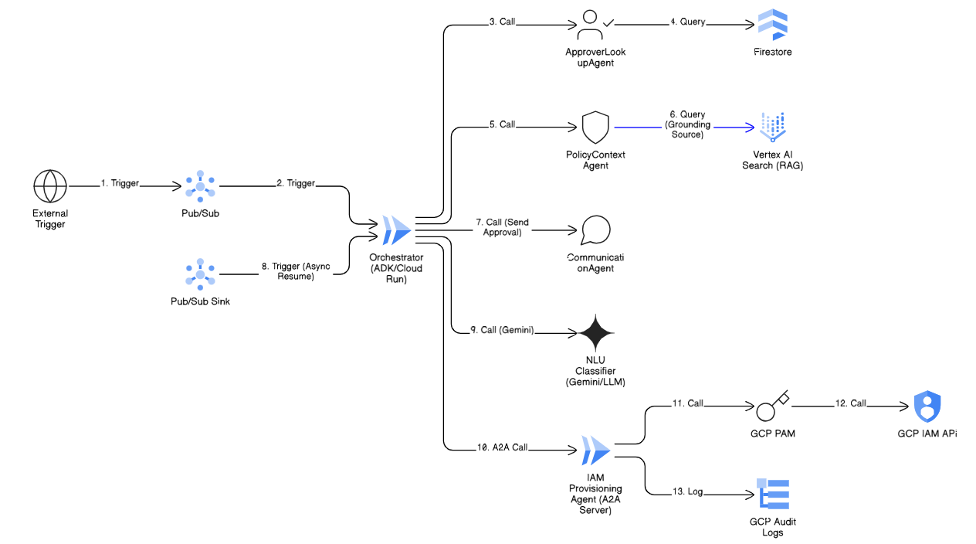
Multi-Agent Architecture

Slide 4
Happy Path Sequence
1
Request Initiated
Developer requests Editor role
0s
2
Approver Lookup
Query Firestore → alice@example.com
1s
3
Policy Retrieval
RAG → PROD-ACCESS-POLICY-v2
2s
4
Compliance Check
Business hours ✓ (10 AM Wed)
3s
5
Email Sent
Gmail API → Approve/Deny buttons
4s
6
Approval Received
JWT validated → Pub/Sub trigger
8s
7
NLU Classification
Gemini 2.5 → APPROVED
10s
8
A2A Execution
Isolated provisioning service
12s
9
Policy Applied
1-hour conditional binding
15s

Slide 5


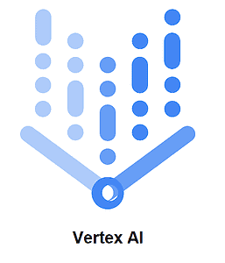
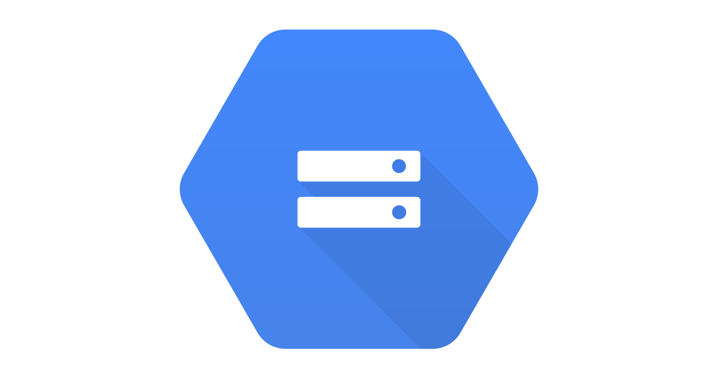
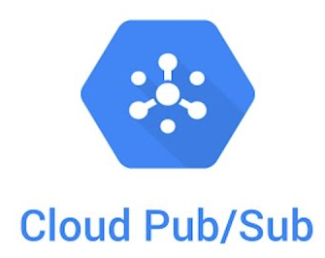






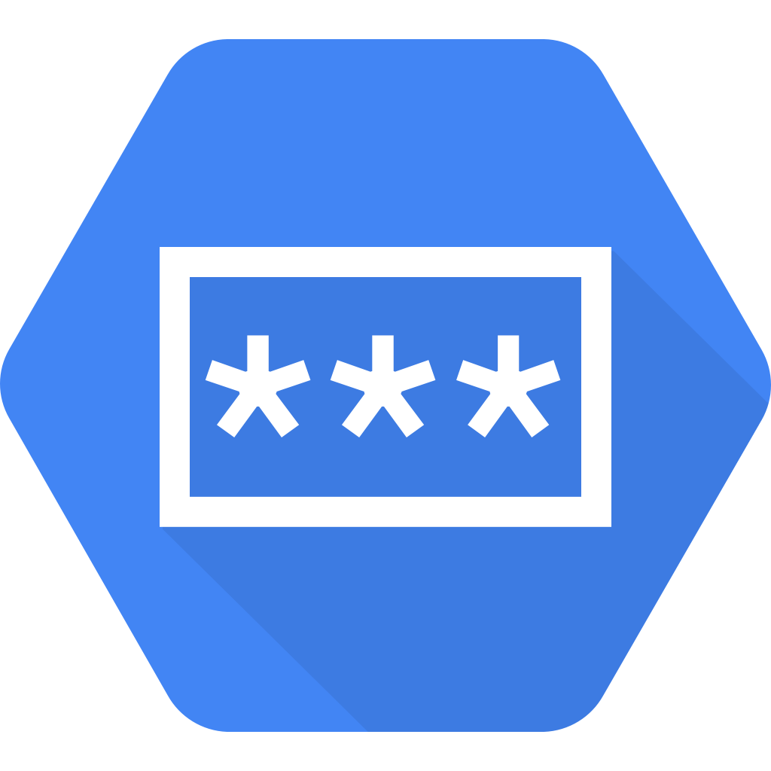
Zero-Trust IAM - Technical
Cloud Run – Scalable agent hosting
Vertex AI Search – RAG Policy Retrieval
A2A Isolation
Service Account Auth
Cloud Storage – Compliance Policy docs
Privileged service beyond protocol boundary
ID token validation middleware
Pub/Sub – Async event processing
Gmail API – Approval Communication
Firestore – Session & audit storage
JWT-Signed Links
Temporal Guards
Gemini 2.5 – NLU Classification
Cryptographically secure approval tokens
Active enforcement of time restrictions
Cloud IAM – Policy Execution
Secret Manager – JWT Key

Slide 6
Business Impact
15 sec
9 steps
Provisioning Time
Automated Workflow
Vs hours manually
End-to-end orchestration
100%
9 GCP
Audit Coverage
Services Integrated
Immutable trail
Production-grade

